Slide 1
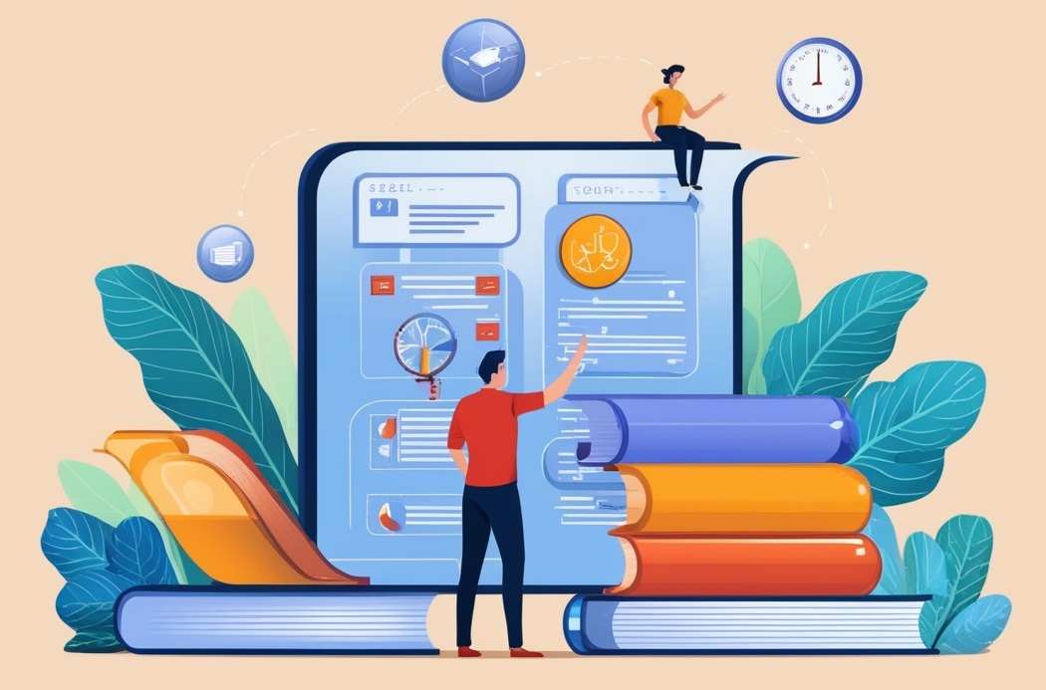
DESIGN AND ANALYSIS OF ALGORITHMS
Dr. Kashif Ayyub

Slide 2
Algorithms as Technology
If computers were infinitely fast and computer memory were free, would you have any reason to study algorithms? The answer is yes, Of course, computers may be fast, but they are not infinitely fast. Computing time is therefore a bounded resource, which makes it precious.
Problem: Sorting n values
Input Size: 10⁷ numbers (10 million)
Computer – A is 1000 times faster than Computer - B
 | Computer – A | Computer – B
Speed | 10¹⁰ inst/sec | 10⁷ inst/sec
Algorithm | Bubble Sort | Merge Sort
Complexity | 2n² | 50nlgn
Programmer | World’s Best | Average
Language | Machine | High-Level
2 x (10⁷)² inst
10¹⁰ inst/sec
= 20,000 seconds
= more than 5.5 hours
50 x 10⁷ x lg10⁷ inst
10⁷ inst/sec
= 1,163 seconds
= less than 20 minutes

Slide 3
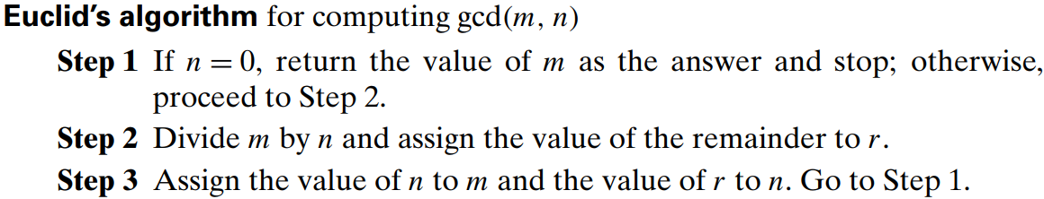
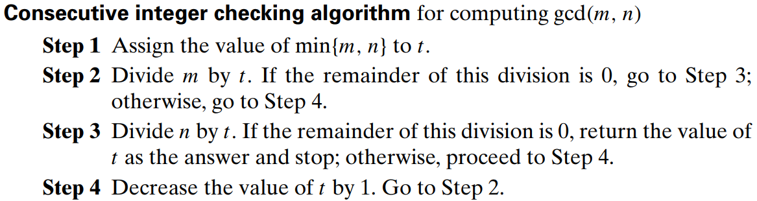
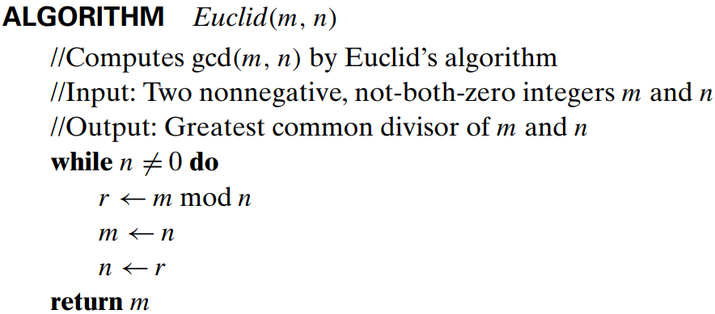
Representation of an Algorithm
An algorithm can be represented in many ways, for example, a GCD aglorithm

Slide 4
Properties of an Algorithm
Input: An algorithm requires one or more inputs. The values that are first supplied to the algorithm before its processing are known as inputs. These inputs come from a predetermined range of acceptable values.
Output: One or more outputs must be produced by an algorithm. The output is the outcome of the algorithm after every step has been completed. The relationship between the input and the result should be clear.
Precision: The steps must be precisely stated.
Finiteness: An algorithm must terminate after a finite number of steps in all test cases. Every instruction which contains a fundamental operator must be terminated within a finite amount of time.
Definiteness: All instructions in an algorithm must be unambiguous, precise, and easy to interpret. By referring to any of the instructions in an algorithm one can clearly understand what is to be done.
Correctness: The algorithm should produce correct results for all possible input data.
Generality: Rather than being limited to a single particular case, an algorithm should be able to solve a group of issues. It should offer a generic fix that manages a variety of inputs inside a predetermined range or domain.

Slide 5
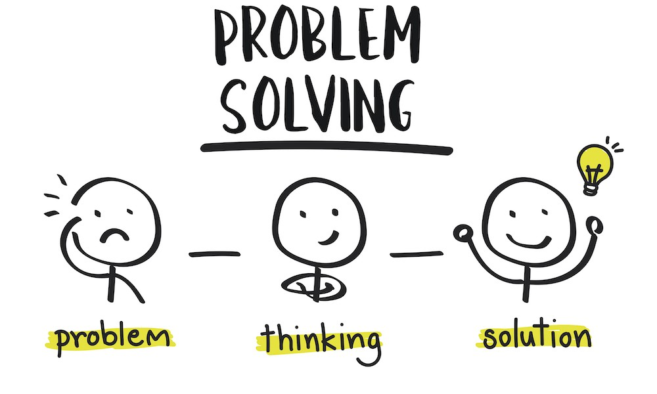
Problem-Solving: An Art and a Science
Problem-solving can be seen as more of an art than a science.
Each person has different ways of approaching problems.

Slide 6
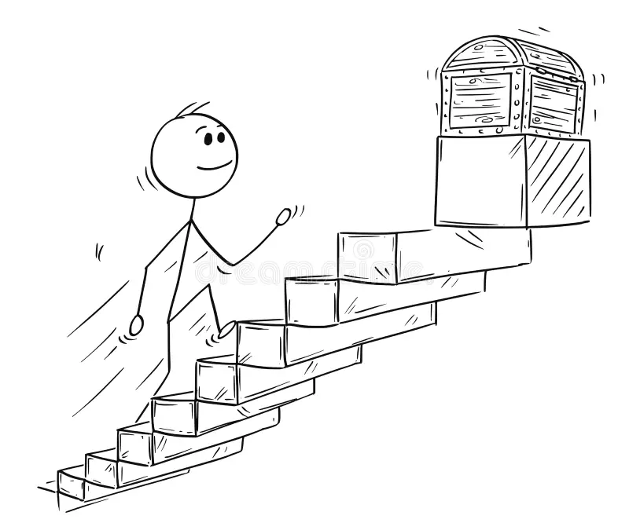
STAIR Steps for Solving Problems
STAIR is an acronym designed to guide your problem-solving process.
Each letter represents a critical step in developing a solution.
S - State the problem
T - Tools for the job
A - Algorithm development
I - Implementation of the algorithm
R - Refinement

